Slide 1
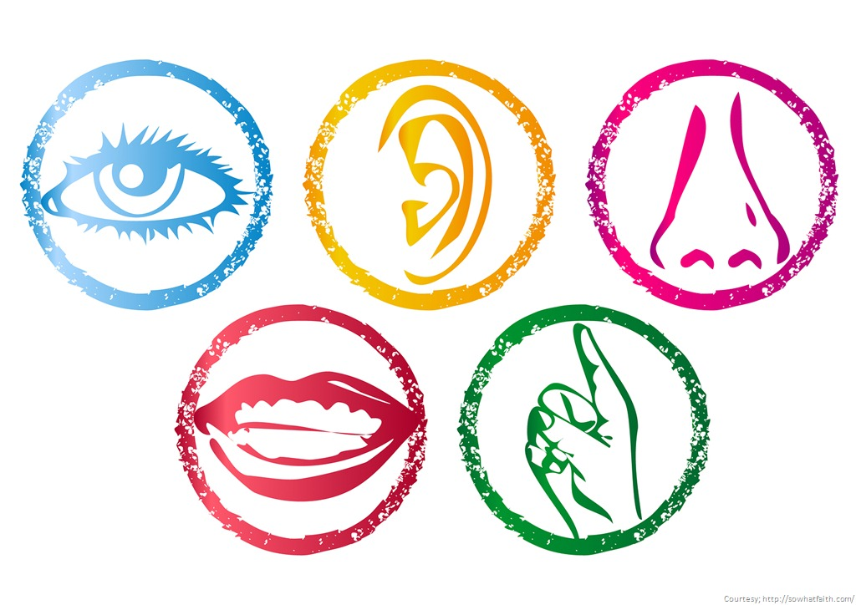
The Five Senses &
Body Parts
White III

Slide 2


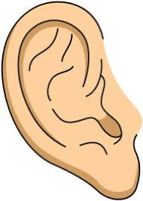

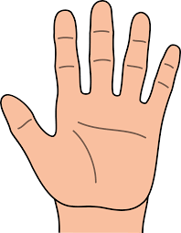
SIGHT
SMELL
TOUCH
HEARING
TASTE

Slide 3
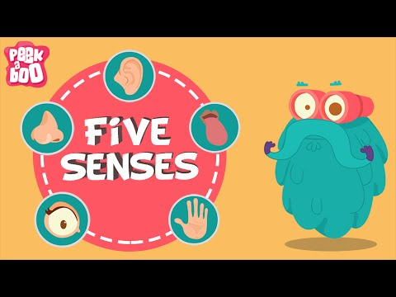

Slide 4


Slide 5


Slide 6
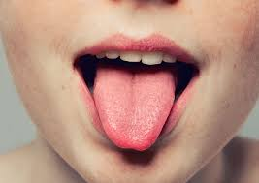
Tongue

Slide 7

Hair

Slide 8
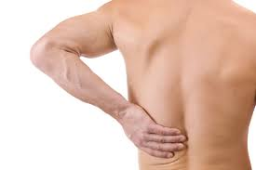
Back

Slide 9

Neck

Slide 10

Body

Slide 11
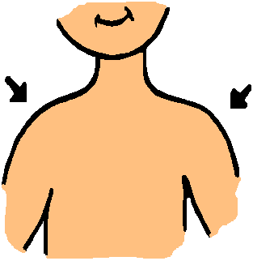
Shoulder

Slide 12
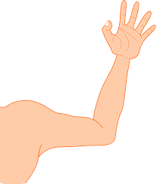
Arm

Slide 13
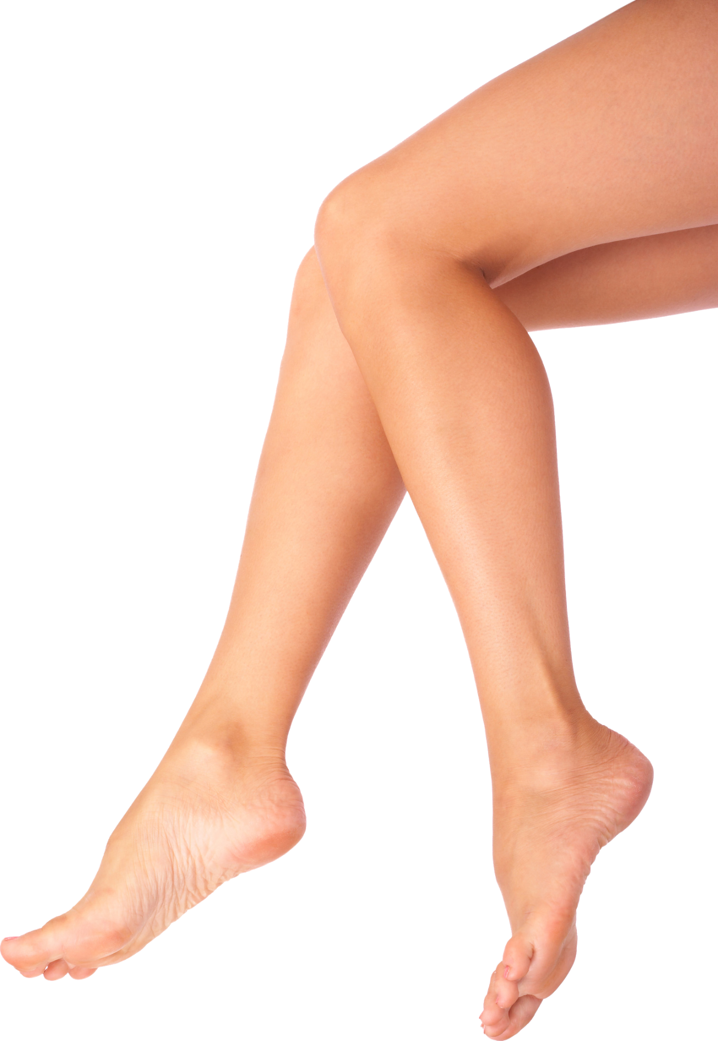
Legs

Slide 14
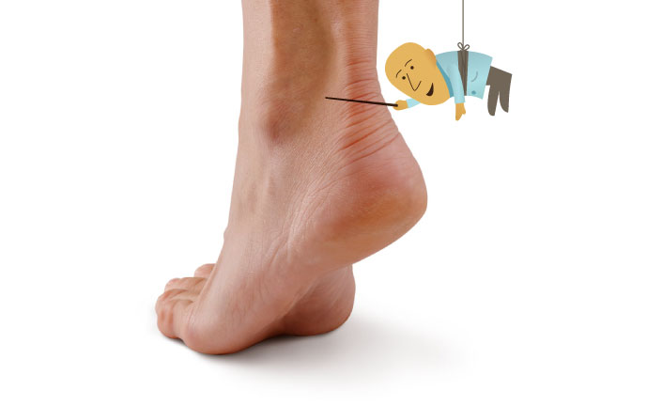
Ankle

Slide 15
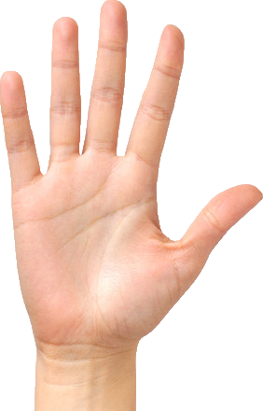
Hand

Slide 16
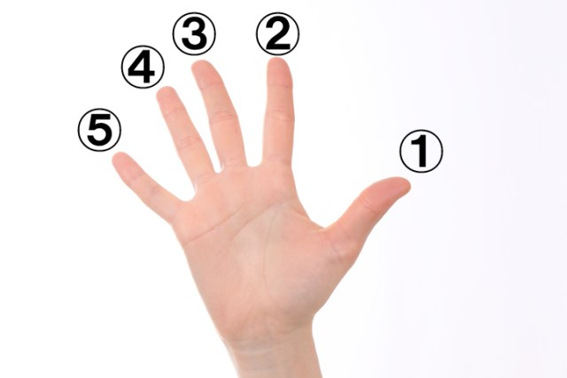
Fingers

Slide 17
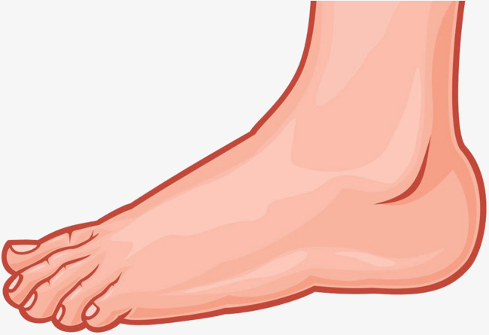
Foot = 1

Slide 18
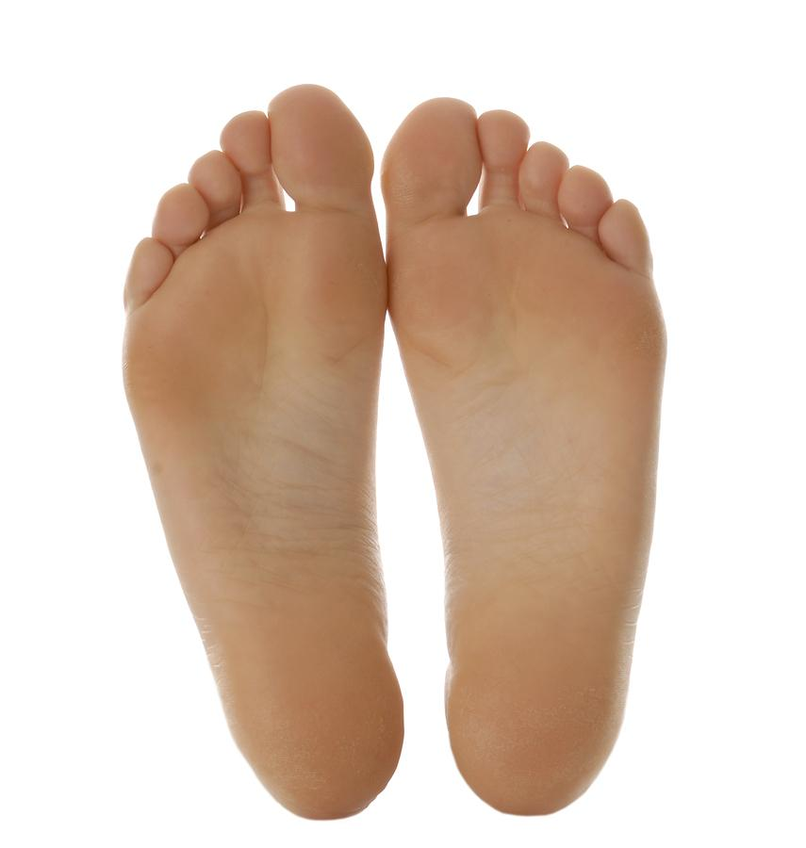
Feet = 2

Slide 19
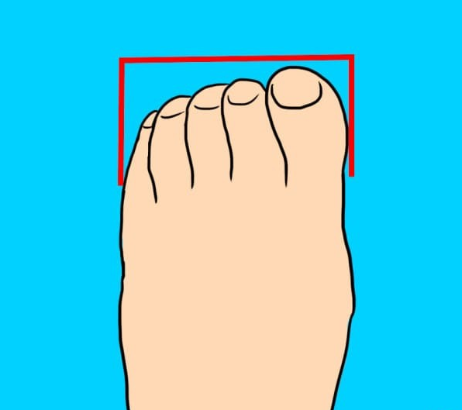
Toes

Slide 20
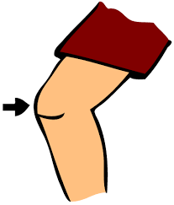
Knee

Slide 21

Head

Slide 22


